Slide 1
MeetMeet
Jeremy Choyce, Eve Ciancia, Brian Grillo, Chris Houze,
John Madigan III, Kevin Shea, Benson Xu

Slide 2
Profiles
Users can input their gender and a biography describing themselves
Users can rate each other positively or negatively
Users can see the ratings of other users
Users can find other users within a 5 mile radius of themselves

Slide 3
Messaging
We’re using Google Cloud Messaging for pushing notifications to the user’s device
SQLite was used to store the messages on the user’s device
Users can block other users if they feel offended or threatened

Slide 4
Groups
Groups were added to allow users to meet in a safer environment
Groups are formed when two a request from an ungrouped user is accepted by another ungrouped user
Groups do not have maximum size, you can add as many people as you want!
Group members can send messages to all the other members

Slide 5
Server
Amazon Web Services free tier of server was used to host our service
Node.js was used for the webapi
MySQL was used for the database to store user information

Slide 6
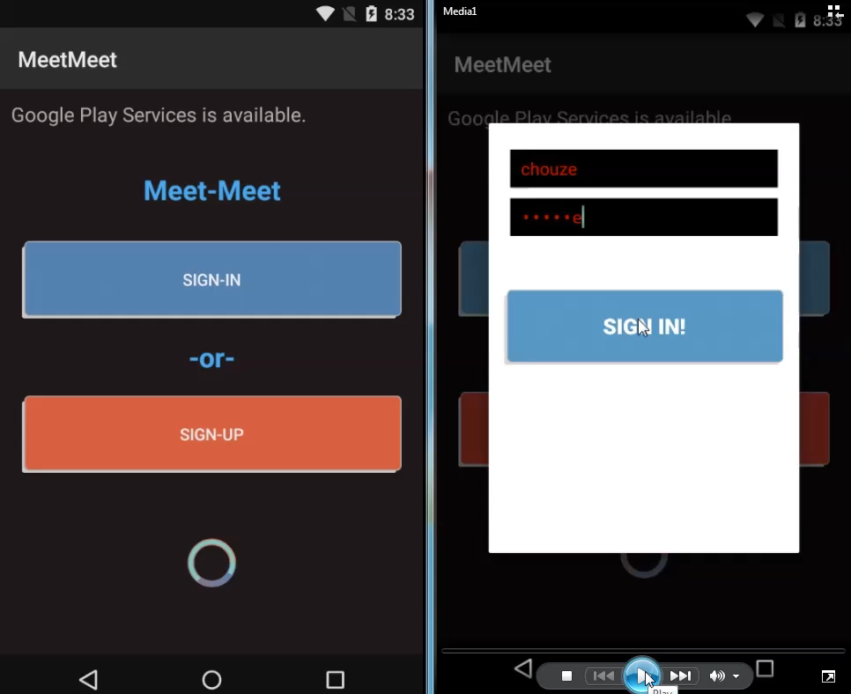
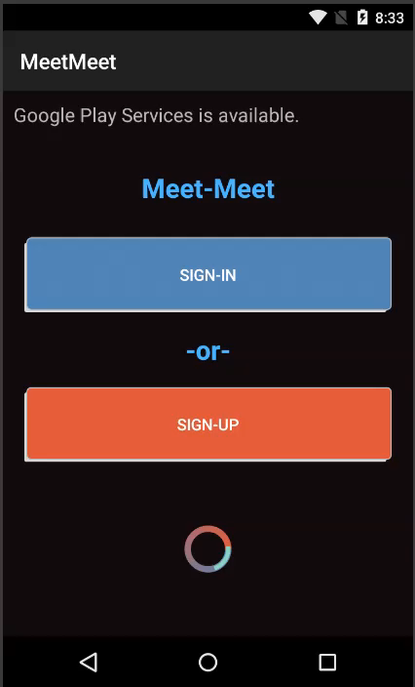
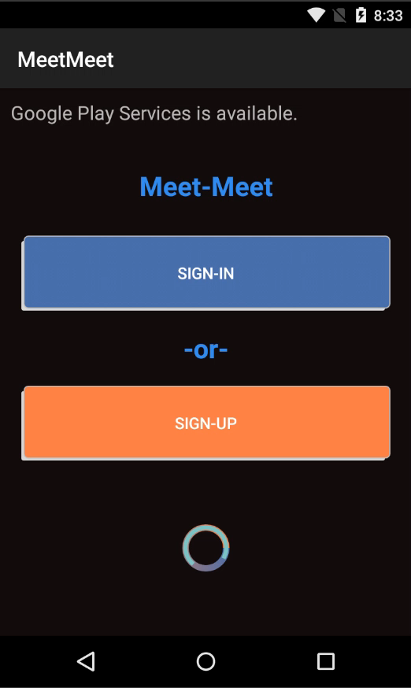

Slide 7
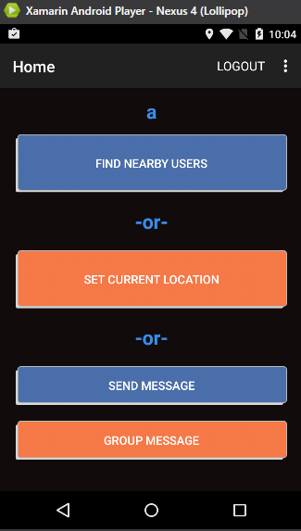
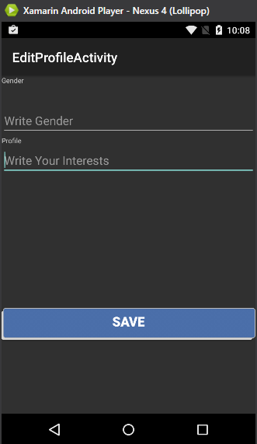
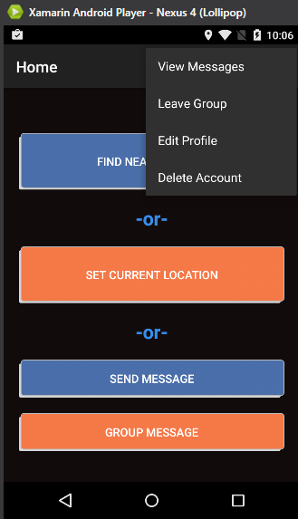
GUI
Simple and User-Friendly
Main Layout
Large Buttons
Color Scheme for Color Impaired
Text Input Boxes with Hints
Drop Down Menu
Easy Access to Four Key User Features at Any Screen
View/Message Interface
Edit Profile
Leaving Group Messaging
Deleting User Account

Slide 8
Geolocation
The operation was optimized by first finding a bounding box, and excluding any profiles not within the box
A Great-circle distance formula was used to further refine the results down to those within the radius

Slide 9

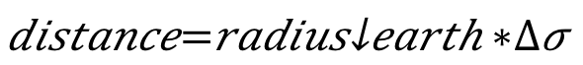
Geolocation
After the user profiles are reduced, the spherical law of cosines is used to calculate the distance between two users:
Any profiles farther than the target distance from the current profile are discarded

